Slide 1
To learn more about a concept in the above mind map, hover your mouse pointer over it. If you have a touch screen, such as an iPhone, then tap the concept.
The information will be displayed here.

Slide 2

Learning is the process of acquiring a relatively permanent change in understanding, attitude, knowledge, information, and/or skill through experience.
Wittrock, M., ed. (1977). Learning and Instruction. McCutchan, Berkeley, CA.

Slide 3

Explicit knowledge can normally be transmitted or taught to others by being articulated into 1) formal language, such as grammatical statements, mathematical expressions, or specifications; and 2) images, such as drawings, symbols, or pictures.
It can normally be processed by a computer, transmitted electronically, or stored in databases.
Nonaka, I., Takeuchi, H. (1995). The Knowledge-Creating Company: How Japanese Companies Create the Dynamics of Innovation. New York: Oxford University Press.

Slide 4

Information Harvesting is often the beginning of a learning episode in order to provide the learner with a basic foundation. During the gathering process the learner stores and organizes most of the information by LATCH (Location, Alphabet, Time, Category, or Hierarchy), which has a lot of versatility. For example, a youngster with a toy car collection may sort them by color, make, type, size, type of play, or a dozen other divisions.
Wurman, S. (2001). Information Anxiety 2 Indianapolis: Que)

Slide 5
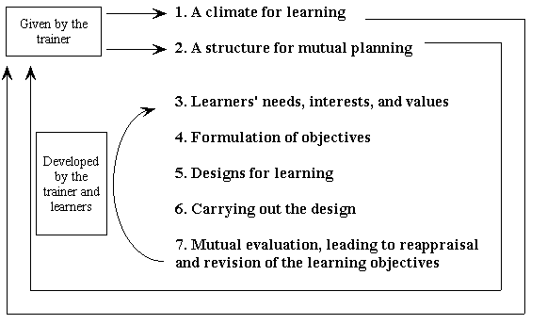
Active Learning Process Model
As shown in this process model, Active Learning means the learners are not only responsible for the actual learning, but also involved in the design of the learning process itself.
Laird D. (1985). Approaches to Training and Development. Reading, MA: Addison-Wesley.

Slide 6

Lectures can be an effective and efficient method to depart knowledge. Studies have found them to be just as effective as other methods, such as group discussions, when it comes to instructing declarative knowledge (knowing “that”), as opposed to procedural knowledge (knowing “how”).
Pascarella, E. T., Terenzini, P. T. (1991). How College Affects Students. San Francisco: Jossey Bass.
However, the learning environment needs to remain a place for active learning, when possible put the lecture in an audio file, such as mp3, for portability (known as “flipping the classroom”: assigning lectures as out-of-class work and performing active learning in class en route to learner-led mastery).

Slide 7

Modeling is often referred to as “social learning theory” as it emphasizes the role of vicarious experience (observation) of people impacting people (models). Modeling has several effects on learners (it is not merely “imitation”):
Acquisition - New responses are learned by observing the model.
Inhibition - A response that otherwise may be made is changed when the observer sees a model being punished.
Disinhibition - A reduction in fear by observing a model's behavior go unpunished in a feared activity.
Facilitation - A model elicits from an observer a response that has already been learned.
Creativity - Observing several models performing and then adapting a combination of characteristics or styles.
Bandura, A. (1997). Social Learning Theory. Englewood Cliffs, NJ: Prentice Hall.

Slide 8
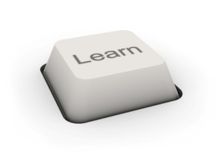
Marshall McLuhan called audio a hot medium in that it extends one single sense in high definition (filled with data). Thus, a photograph has high definition, while a sketch or cartoon normally has low definition. Low definition media invites participation as you have to fill in the missing pieces.
High definition media creates a private experience, such as viewing a photograph or listening to an iPod. A book is normally high-definition. It can provide even more data than listening as most people read faster than a good speaker can talk. Yet the context is quite different. When you have a thought while reading, you pause, reflect, and then continue reading. The data simply comes too fast to try to do both reading and reflecting at the same time. If one tries to do another task while reading, the mind tends to zone out to what is known as mindless reading.
McLuhan, M. (1964). Understanding Media: The Extensions of Man. Massachusetts: First MIT Press.

Slide 9

Performance-Based Learning (PBL) achieves a balanced approach by extending traditional fact-and-skill instruction. PBL is not a curriculum design as you decide what to train, but rather a better way to deliver curriculum. Authentic tasks are rooted in the curriculum, thus based on what already works for trainers. Assignments are more authentic and meaningful as learning is based on “performing it” rather than “knowing it.”
Educators in Connecticut's Pomperaug Regional School District 15. (1996). A Teacher's Guide to Performance-Based Learning and Assessment. Hibbard, M. (ed). VA: ASCD.

Slide 10
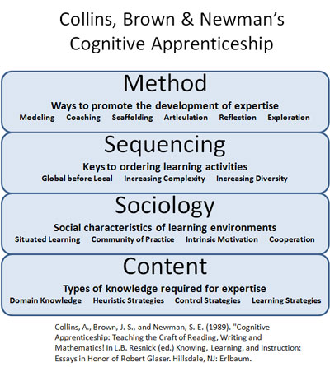
Cognitive Apprenticeship is learning-through-guided-experience on cognitive and metacognitive, rather than physical, skills and processes. It is composed of four main concepts: Methods, Sequencing, Sociology, and Content (or knowledge). Each of the four concepts have several parts within them as shown in this model.

Slide 11

Cooperative Learning is used in tutoring and coaching situations. The learners work in small groups on an assigned project or problem under the guidance of an expert who ensures they stay on task and identify the correct answers. It includes five basic elements:
Individual Accountability - The learners work on a clear task with a group goal. All learners must make a contribution.
Positive Interdependence - The group is accountable for achieving its goals and each individual member is accountable for a identifiable contribution.
Face-To-Face interaction - Learners interact with to discuss problems, explain their learning to each other, and tease out ideas
Social Skills - Groups skills, such as attentive listening, questioning to clarify ideas, eliciting responses, or disagreeing in a constructive way are explicitly taught. Their development is not left to chance.
Group Processing (Reflection) - Groups reflect on the cooperative learning skills they have used and consciously focus on developing their skills by working together.

Slide 12
Problem-Based Learning is a learner-centered pedagogy in which people learn about a subject in the context of complex, multifaceted, and realistic problems . The goals are to help the learners develop flexible knowledge, effective problem solving skills, self-directed learning, effective collaboration skills and intrinsic motivation.
Hmelo-Silver, C.E. (2004). Problem-based learning: What and How Do Students Learn?. Educational Psychology Review, 16(3)
Problem-Based Learning implies a deductive approach--rather than being presented with a complete set of concepts, rules, and strategies that explicitly instructs the learners, they must explore and experiment with the task to infer and learn the rules, principles, and strategies for effective performance.

Slide 13
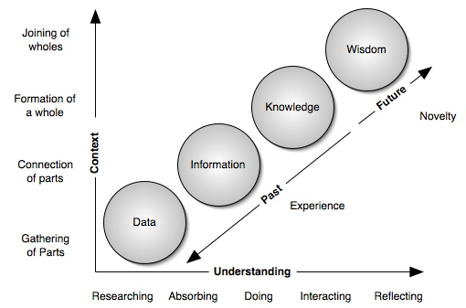
One gains knowledge through context (experiences) and understanding.
When one has context, one can weave the various relationships of the experiences. The greater the context, the greater the variety of experiences that one is able to pull from.
The more one understands the subject matter, the more one is able to weave past experiences (context) into new knowledge by absorbing, doing, interacting, and reflecting.

Slide 14

Case Studies normally come in two forms. The first is problem specific in that it tends to use very short and specific kinds of cases in which the problem is transparent. With this kind of case study, the learners can demonstrate their problem solving ability using theories that have been previous taught.
The second method uses cases that allow the learners to apply their knowledge and skills. This type of case study uses complex and lengthy information which must be deeply analyzed. The problems may not easily be defined. In addition, the case may not be about a problem needing a solution, but rather about engaging various perspectives on an issue. The purpose of this method is about helping learners to identify problems, issues, and opportunities, as well as about fitting solutions and developing the logic that supports both problem identification and proposed solution or actions.

Slide 15

Inquiry Based Learning (IBL) is a learning method that assesses how well the learners develop experimental and analytical skills, rather than how much knowledge they possess. Memorizing facts and information is not always the most important skill in today's world as facts can rapidly change, and information is now more readily available, thus IBL focuses on understanding how to get and make sense of the mass of data.

Slide 16
Unlike explicit knowledge that can be articulated , Tacit knowledge is personal knowledge embedded in individual experience and involves intangible factors, such as personal beliefs, perspective, and the value system. It contains subjective insights, intuitions, and hunches. Before tacit knowledge can be communicated, it must be converted into words, models, symbols, or numbers that can be understood.
Nonaka, I., Takeuchi, H. (1995). The Knowledge-Creating Company: How Japanese Companies Create the Dynamics of Innovation. New York: Oxford University Press.
The Two dimensions of Tacit Knowledge
Technical Dimension (procedural): This encompasses the kind of informal and skills often captured in the term know-how. For example, a craftsperson develops a wealth of expertise after years of experience. But a craftsperson often has difficulty articulating the technical or scientific principles of his or her craft. Highly subjective and personal insights, intuitions, hunches and inspirations derived from bodily experience fall into this dimension.
Cognitive Dimension: This consists of beliefs, perceptions, ideals, values, emotions and mental models so ingrained in us that we take them for granted. Though they cannot be articulated very easily, this dimension of tacit knowledge shapes the way we perceive the world around us.

Slide 17

In Discovery Learning, the learners search for new knowledge in order to discover facts and relationships and new truths to be learned. This is normally performed with little, if any, assistance. It is based on constructivist learning theory that takes place in problem solving situations where the learners draw on their past experience and existing knowledge base.
Bruner wrote, “Emphasis on discovery in learning has precisely the effect on the learner of leading him to be a constructionist, to organize what he is encountering in a manner not only designed to discover regularity and relatedness, but also to avoid the kind of information drift that fails to keep account of the uses to which information might have to be put.”
Bruner, J.S. (1967). On knowing: Essays for the left hand. Cambridge, Mass: Harvard University Press.

Slide 18
Action Learning is normally conducted over a period of 6 to 9 months. Learning is centered around the need to find a solution to a real problem. A team of learners with diverse backgrounds conduct field projects on complex organizational problems that require the use of skills learned in formal training sessions. The learning team then meet periodically with a skilled instructor to discuss, analyze, and learn from their experiences. In addition, individual development is just as important as finding the solution to the problem
Revans, R.W. 1998. ABC of action learning. London: Lemos and Crane.
The are six steps in Action Learning:
Formulate Hypothesis (an idea or concept)
Design Experiment (consider ways of testing truth or validity of idea or concept)
Apply in Practice (put into effect, test of validity or truth)
Observe Results (collect and process data on outcomes of test)
Analyze Results (make sense of data)
Compare Analysis (relate analysis to original hypothesis)

Slide 19
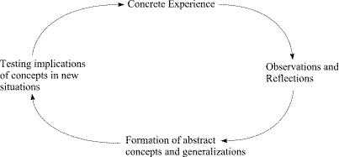
Action Research is a reflective process of progressive problem solving led by individuals working with others in teams or as part of a community of practice to improve the way they address issues and solve problems.
Learning is best facilitated when there is a conflict between immediate concrete experience and detached analysis within the individual. This cycle of action, reflection, generalization, and testing is characteristic of experiential learning.
Kurt Lewin originated the term in 1944

Slide 20

Collaborative Learning is similar to cooperative learning in that the learners work together in small teams to increase their chance of deeper learning. However, it is a more radical departure from cooperative learning in that there is not necessarily a known answer. For example, trying to determine the answer to “how effective is elearning?” would be collaborative learning as there are a wide ranges of possibilities to this question, depending upon the learners' perspectives. Because the collaboration sometimes results from less purposeful and focused activities, some of the learning will be unintentional or serendipitous.

Slide 21
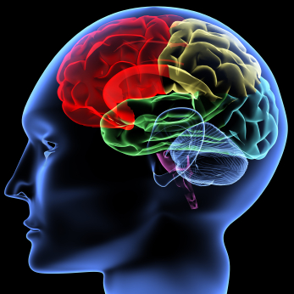
Metalearning is being aware of taking control on one’s own learning. In order to do this one has to first understand the basics and phenomenon of learning.
The process of metalearning enables a person to more easily master complex tasks, such as those requiring tacit knowledge.
Biggs, J.B. (1985). The role of meta-learning in study process. British Journal of Educational Psychology, 55, 185-212

Slide 22

Metaphors can aid the transfer of tacit knowledge to explicit knowledge through the use of Externalization— The quintessential process of articulating tacit knowledge into explicit concepts through metaphors, analogies, concepts, hypothesis, or models.
Nonaka, I., Takeuchi, H. (1995). The Knowledge Creating Company. New York: Oxford University Press.

Slide 23

Reflection is thinking for an extended period by linking recent experiences to earlier ones in order to promote a more complex and interrelated mental schema. The thinking involves looking for commonalities, differences, and interrelations beyond their superficial elements. The goal is to develop higher order thinking skills. Dewey thought of reflection as a form of problem solving that chained several ideas together by linking each idea with its predecessor in order to resolve an issue.
Dewey, J. (1933). How We Think: A Restatement of the Relation of Reflective Thinking to the Educative Process. Boston: D.C. Heath.

Slide 24
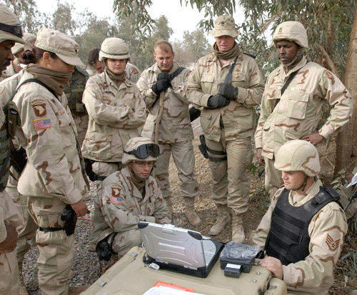
Story Telling and Narratives are means of sharing experiences to create tacit knowledge, such as shared mental models and technical skills.
Nonaka, I., Takeuchi, H. (1995). The Knowledge Creating Company. New York: Oxford University Press.
A narrative is a constructive format (as a work of speech, writing, song, film, television, video games, photography or theatre) that describes a sequence of non-fictional or fictional events.

