Slide 1
Incident
From which you build
Sweep One:
Incident identification
and selection
Timeline
1:00 2:00 3:00 4:00
Sweep Two:
Timeline verification (may
be in days)
Decision point identification
Goals
Expectancies
Cues
Hypothetical
Look for Cues
Expert-Novice Contrast
Decision
1
Decision
2
Decision
3
Sweep three:
Progressive
deepening
Initial
Sweep Four:
What if queries
Expert-Novice differences

Slide 2
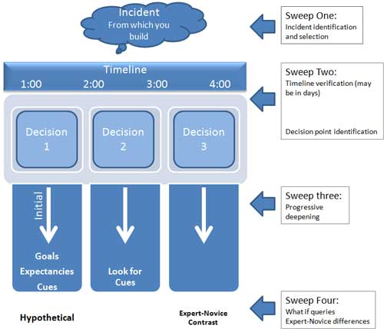
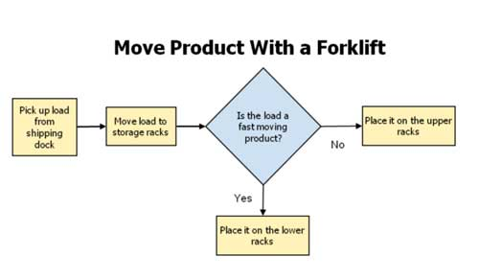
Turn on computer and start spreadsheet application.
Load projected sales report spreadsheet template (prosale.exl).
Enter projected sales figures into designated spreadsheet cells.
Run spreadsheet macros.
Save file under new name -- pro***.exl, with *** being the next
sequential number, for example pro135.exl. Note: Do NOT overwrite template.
Forward to Planning Manager by email.
Exit application.

Slide 3
Leadership
Interpersonal
Effectiveness
Efficiency
Control
Command
Conceptual
Management

Slide 4
Leadership
Visions,
Creativity
&
Ideas
Feedback
Loop
(Learning )
Interpersonal
Effectiveness
Efficiency
Control
Command
Conceptual
Products
&
Services
Affordability
&
Productivity
Management

Slide 5
Leadership
Organization
loses purpose
of mission
Leaders
fail to learn
Interpersonal
Effectiveness
Efficiency
Control
Command
Conceptual
Dilbert’s
Pointy Hair
Boss
Products
turn to crap
Management

Slide 6
Leadership
Structure
rather than
balance
Failure to
visualize &
create
Interpersonal
Effectiveness
Efficiency
Control
Command
Conceptual
Efficiency
overrides
Effectiveness
Over-
supervision
Management

